Slide 1

Subjective answer evaluation

Slide 2

Gayatri Vidya Parishad College of Engineering (Autonomous) Madhurawada, Visakhapatnam – 530048 Under the esteemed guidance of p. Praveen kumar Assistant Professor Department of Information Technology
PROJECT TEAM MEMBERS:
G. varsha -20131A1218
K. Venkat Sai Krishna -20131A1225
M. sai Vaibhav Venkat-20131a1230
P. laxmi praneela-20131a1237

Slide 3
CONTENTS
Abstract
Introduction
Requirements Specification
Software Requirements
Hardware Requirements
Non-Functional Requirements
Functional Requirements
Analysis
Software Description
Project Description
System Architecture
Flow chart
UML Diagrams
Development
Conclusion
Future Scope
Bibliography

Slide 4
ABSTRACT
Assessing subjective papers manually is both challenging and tedious, primarily due to the complexities involved in comprehending and interpreting the data. Previous attempts to automate the scoring of students' answers using computer science have predominantly relied on basic word counting methods. This project proposes an innovative approach that harnesses advanced techniques from machine learning and natural language processing, including Word Mover's Distance (WMD) and Term Frequency-Inverse Document Frequency (TF-IDF), to autonomously evaluate descriptive answers. The evaluation process involves the utilization of solution statements and keywords, and a machine learning model is trained to predict answer grades. Notably, the study incorporates additional measures such as Jaccard Similarity, Smooth Inverse Frequency (SIF) embedding similarity, METEOR score, and BLEU score to enrich the assessment process. Results indicate that WMD outperforms other metrics, highlighting the effectiveness of incorporating diverse measures. With sufficient training, the machine learning model has the potential to operate as a standalone solution, streamlining the assessment of subjective papers and reducing the burden of manual grading.

Slide 5
INTRODUCTION
This project introduces an innovative solution for automating the evaluation of subjective papers. It employs advanced techniques from machine learning and natural language processing, such as Word Mover's Distance (WMD), TF-IDF, Jaccard Similarity, and more, surpassing traditional word counting methods. The framework aims to autonomously assess descriptive answers, reducing manual grading burden while ensuring objectivity. Through rigorous comparison and validation of metrics, the project highlights the superiority of WMD. Its scalability and potential for generalization make it applicable across diverse educational settings. Overall, this project signifies a significant advancement in automating subjective paper evaluation, with implications extending beyond education.

Slide 6
SRS REQUIREMENT SPECIFICATION
The software requirements are description of features and functionalities of the target system. Requirements convey the expectations of users from the software product. The requirements can be obvious or hidden, known or unknown, expected or unexpected from client’s point of view. OPERATING SYSTEM Windows is a graphical operating system developed by Microsoft. It allows users to view and store files, run the software, play games, watch videos, and provides a way to connect to the internet. It was released for both home computing and professional works. SDK stands for software development kit or devkit for short. It’s a set of software tools and programs used by developers to create applications for specific platforms. SDK tools will include a range of things, including libraries, documentation, code samples, processes, and guides those developers can use and integrate into their own apps. SDKs are designed to be used for specific platforms or programming languages.Some of SDK’s used in this project are stated below:
1.NLTK 2.Django 3.Transformers 4.Scikit-Learn 5.Gensim 6.Textgears API 7.Python2 .
Hardware Requirements:
The most common set of requirements defined by any operating system or software application is the physical computer resources, also known as hardware.
The following sub-sections discuss the various aspects of hardware requirements.
The Hardware Interfaces Required are:
Ram: Minimum 8GB or higher
GPU: 4GB dedicated
SSD: 128GB
Processor: Intel i5 10th Gen or Ryzen 5 with Octa core.

Slide 7
Non-Functional Requirements:
Non-Functional Requirements are the constraints or the requirements imposed on the system.
Non-Functional Requirements address vital issues of quality for software system.
It includes below things:
Capacity,
Availability and
Performance etc.
Python Libraries To be installed:
The following libraries with the specific versions type must be installed for this project to function.
These can be installed using command “pip install library name = = version" .

Slide 8
ANALYSIS
EXISTING SYSTEM : Current assessment methods for subjective papers predominantly involve manual grading or basic automated approaches. Manual grading is time-consuming, labor-intensive, and susceptible to subjective biases, leading to inconsistencies in scoring. On the automated side, many systems use simplistic word counting methods that struggle to capture the complexities of subjective answers, resulting in a simplified evaluation process These approaches often lack the sophistication needed to understand the nuances of language, making it challenging to provide meaningful feedback. Automated systems relying on basic algorithms may struggle with context, creativity, and a deep understanding of well-crafted responses. In essence, existing systems face challenges in terms of consistency, subjectivity, and the ability to comprehensively evaluate the intricate nature of subjective answers. Recognizing these limitations emphasizes the need for a more intelligent and nuanced system, which is the focal point of our innovative approach.
PROPOSED SYSTEM : The innovative automated assessment system, blending advanced machine learning and natural language processing, revolutionizes education. Utilizing techniques like Word Mover's Distance and cosine similarity, it streamlines subjective paper grading, providing timely and insightful feedback. This dynamic tool enhances language learning, refines research paper reviews, and transforms the online learning experience for educators and students alike.Our automated assessment system integrates machine learning and natural language processing. Our engineering solution streamlines subjective paper grading, provides timely feedback, and enriches the learning experience, contributing to educational advancement by Leveraging Word Mover's Distance, cosine similarity, Multinomial Naive Bayes, and TF-IDF.

Slide 9
SOFTWARE DESCRIPTION
Transformers: Transformers are deep learning models crucial in evaluating subjective papers. By using transformer-based sentence embeddings like BERT or RoBERTa, the project captures semantic nuances in text paragraphs. This enhances the accuracy of automated evaluation by understanding subtle meanings and similarities between paragraphs. Transformers offer scalability and adaptability, making the evaluation framework efficient across various subjective papers and tasks.
Gensim: Gensim is a Python library known for NLP tasks like topic modeling and similarity retrieval. It helps uncover patterns in text data, aiding in tasks such as topic extraction and document clustering. Gensim's memory-friendly implementations support processing large text corpora efficiently, making it a powerful tool for extracting insights from textual data.
Word2vec: Word2Vec is a technique used to learn dense vector representations of words from text corpora. It captures semantic meaning and contextual relationships between words, facilitating tasks like text classification and sentiment analysis. Word2Vec embeddings are widely used in NLP applications for modeling semantic relationships in natural language data.
TextGears: TextGears API offers grammar and spell checking features to identify and correct errors in written content. It helps maintain grammatical correctness and coherence in writing, ensuring professionalism and clarity in communication. TextGears' advanced linguistic algorithms enhance the quality of written content by providing detailed suggestions for error correction.
Faiss: Faiss is an open-source library for efficient similarity search and clustering of high-dimensional data. It supports various algorithms for approximate nearest neighbor search, making it suitable for applications like image retrieval and recommendation systems. Faiss provides fast and scalable solutions for handling large-scale datasets, enabling a wide range of machine learning and data analysis tasks.
NLTK: NLTK is a Python library for natural language processing tasks, offering tools for tokenization, stemming, part-of-speech tagging, and semantic analysis. It includes a rich collection of text processing modules and corpora, making it valuable for academic research and practical applications in NLP.
Django: Django is a high-level web framework for Python, simplifying the development of web applications. It follows the Model-View-Template architectural pattern, providing tools for database interaction, user authentication, and dynamic HTML rendering. Django's security features and extensive documentation make it popular for building secure and scalable web applications.

Slide 10
Project DeSCRIPTION:
PREPROCESSING AND EMBEDDING:
The document undergoes preprocessing to enhance its readability and structure. This may include steps such as tokenization, lowercasing, removing stop words, and punctuation. Paragraphs are embedded using state-of-the-art transformer-based models such as BERT (Bidirectional Encoder Representations from Transformers) or RoBERTa (Robustly optimized BERT approach). Embedded paragraphs are stored efficiently using the FAISS (Facebook AI Similarity Search) library, ensuring fast and scalable retrieval
RETRIEVAL OF RELEVANT ANSWER:
When a specific question is provided, the system retrieves relevant answers from the preprocessed and embedded document. This retrieval is based on semantic similarity between the question and paragraphs in the document. Techniques such as approximate nearest neighbour search are employed to efficiently retrieve relevant answers from a large corpus.

Slide 11
STUDENT RESPONSE EVALUATION
Upon receiving the student's answer to the question, the system evaluates it using various similarity metrics. These metrics include Jaccard Similarity, Word Mover's Distance (WMD) Similarity, BLEU Score, Meteor Score, Soft Cosine Similarity, and SIF Embedding Similarity. Each metric offers a unique perspective on the similarity between the student's answer and the relevant paragraphs from the document.
FINAL SCORE CALCULATION:
The scores obtained from the similarity metrics are combined using a weighted average approach, where each metric is assigned a weight based on its importance. The weighted average score is then adjusted based on the degree of penalization for grammatical errors and spelling mistakes. The resulting score represents the overall quality and relevance of the student's response to the given question.

Slide 12
JACCARD SIMILARITY:
Jaccard Similarity is a measure of similarity between two sets, often used in text analysis and information retrieval. It quantifies the similarity by comparing the intersection and union of the elements in the sets. The formula for Jaccard Similarity is defined as the size of the intersection divided by the size of the union of the sets.
In the context of text analysis, the sets represent the unique words or tokens present in two pieces of text. Jaccard Similarity disregards the order of words and only focuses on whether words are present in both texts or not. It's particularly useful for tasks such as document retrieval, plagiarism detection, and recommendation systems where the arrangement of words may vary but their presence matters
WMD SIMILARITY :
Word Mover's Distance (WMD) is a measure of semantic similarity between two pieces of text, which takes into account the meaning of words and their relationships. Unlike traditional distance metrics like Euclidean distance, WMD considers the semantic meaning of words when computing the distance between documents. WMD measures how similar two documents are by calculating the minimum "cost" of transforming one document into the other, where the cost is defined as the minimum amount of "work" needed to move each word from one document to another. WMD similarity is particularly effective when comparing text documents that may have different lengths, vocabularies, or word choices but convey similar meanings. It is especially useful in applications such as document retrieval, information retrieval, and natural language processing tasks like document clustering and text summarization.

Slide 13
BLUE SCORE:
BLEU (Bilingual Evaluation Understudy) is a metric commonly used to evaluate the quality of machine-translated text by comparing it to one or more reference translations. Originally designed for machine translation tasks, BLEU has since been adapted for use in various text generation and natural language processing applications. BLEU operates by comparing n-grams (sequences of n consecutive words) between the candidate translation and reference translations. It computes precision scores for each n-gram size (typically up to 4-grams) and combines them using a weighted geometric mean to compute the overall BLEU score. The weights assigned to each n-gram precision score are often uniform, although they can be adjusted based on specific preferences or requirements. BLEU penalizes for brevity by comparing the length of the candidate translation to the lengths of the reference translations. This penalty discourages generating overly short translations that may achieve high precision scores simply by omitting content. BLEU scores range from 0 to 1, with higher scores indicating better translation quality. However, it's essential to interpret BLEU scores cautiously and consider them alongside other evaluation metrics, as BLEU has limitations, such as sensitivity to tokenization, inability to capture semantic equivalence, and dependence on reference translations

Slide 14
METEOR SCORE
METEOR (Metric for Evaluation of Translation with Explicit Ordering) is a metric commonly used to evaluate the quality of machine translation and text generation systems. It combines precision, recall, and alignment-based measures to provide a comprehensive evaluation of the similarity between a candidate text and one or more reference texts. Unlike some other metrics like BLEU, METEOR considers not only exact word matches but also stems, synonyms, and paraphrases. This makes METEOR more robust to variations in word choice and sentence structure, capturing a broader range of linguistic similarities between the candidate and reference texts.
The METEOR score is computed based on three main components:
Unigram Precision: Measures the percentage of words in the candidate text that are also present in the reference text(s).
Unigram Recall: Measures the percentage of words in the reference text(s) that are also present in the candidate text.
METEOR combines these components using a weighted harmonic mean to compute the overall score. It also includes a penalty term to account for differences in word length between the candidate and reference texts, penalizing for longer or shorter translations. METEOR scores range from 0 to 1, with higher scores indicating better translation quality. METEOR is widely used in machine translation research and evaluation due to its ability to capture a broader range of linguistic phenomena compared to simpler metrics like BLEU.

Slide 15
SIF EMBEDDING SIMILARITY
SIF (Smooth Inverse Frequency) Embedding Similarity is a metric utilized to gauge the semantic similarity between two text segments based on their embeddings. Unlike simple embedding-based comparisons, SIF embedding similarity incorporates inverse document frequency (IDF) weighting to diminish the impact of common words and elevate the significance of rare terms. The process of computing SIF embedding similarity typically involves several steps. First, each word in the text is converted into a high-dimensional vector using pre-trained word embeddings like Word2Vec or GloVe. These embeddings encapsulate semantic information regarding each word's meaning and context. Next, the embeddings of individual words in the sentence are aggregated to construct a unified vector representation of the entire sentence. This aggregation can be achieved by methods like averaging the word embeddings or employing weighted averages based on word importance. IDF scores are then calculated for each word in the text corpus to quantify its importance in distinguishing between documents. Words with higher IDF scores, which are common across documents, are down weighted, while those with lower IDF scores, indicating rarity, are upweighted. The sentence embeddings are further adjusted using IDF weighting to derive SIF embeddings. This adjustment serves to diminish the impact of common words and amplify the semantic content of the text. Finally, the similarity between two SIF embeddings, representing two sentences, is computed using a standard similarity metric such as cosine similarity. Cosine similarity measures the cosine of the angle between the two vectors, indicating their directional similarity while discounting the influence of common words or noise. SIF embedding similarity proves particularly effective for tasks requiring semantic understanding of text, such as text classification, document clustering, and information retrieval. By incorporating IDF weighting, SIF embedding similarity enhances the discernment of semantic content while mitigating the interference of common terms.

Slide 16
SOFT COSINE SIMILARITY:
Soft cosine similarity is a similarity measure that extends the concept of cosine similarity to handle text documents represented as bags-of-words (BoW) or vectors of word embeddings. Unlike traditional cosine similarity, which operates directly on vectors, soft cosine similarity takes into account the semantic similarity between words by considering their word embeddings.Each document is represented as a weighted sum of its word embeddings. This can be done by averaging the word embeddings of the words in the document, weighted by their term frequency-inverse document frequency (TF-IDF) weights or other weighting schemes.Given two documents represented as vectors v1 and v2 in the embedding space, soft cosine similarity is calculated as the cosine of the angle between the two vectors after accounting for the semantic similarity between words:Soft cosine similarity takes into account the semantic similarity between words by computing the cosine similarity between their embeddings. This allows for more accurate similarity measurements, especially when dealing with documents that contain synonyms, related terms, or variations of the same concept. Soft cosine similarity is particularly useful in tasks such as text similarity, document clustering, and information retrieval, where capturing semantic relationships between words is important.

Slide 17
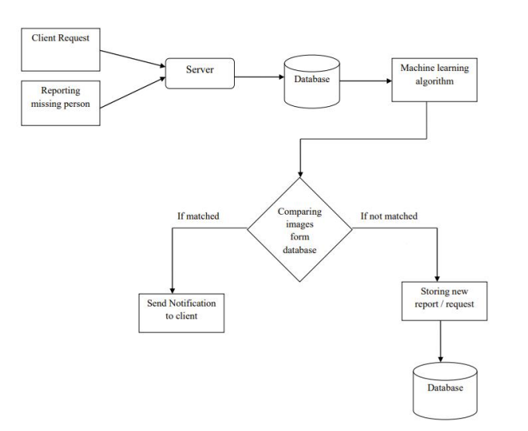
SYSTEM ARCHITECTURE

Slide 18
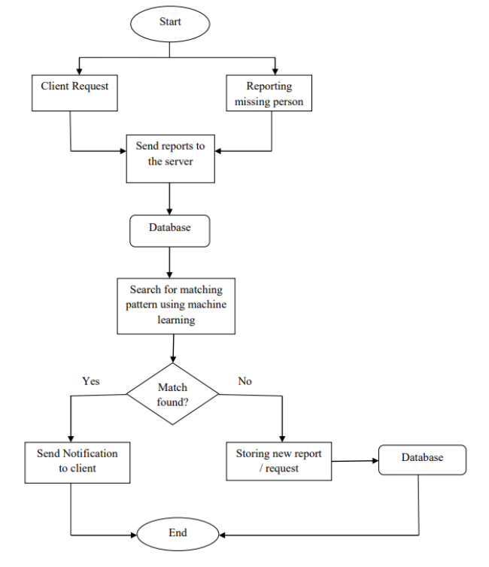
FLOWCHART

Slide 19
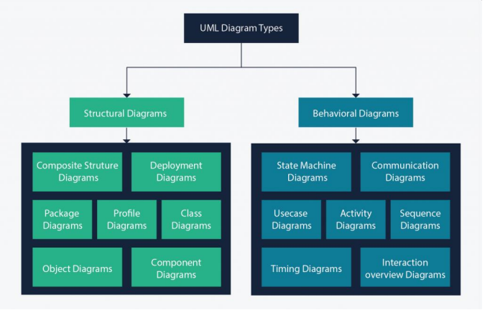
UML DIAGRAMS

Slide 20
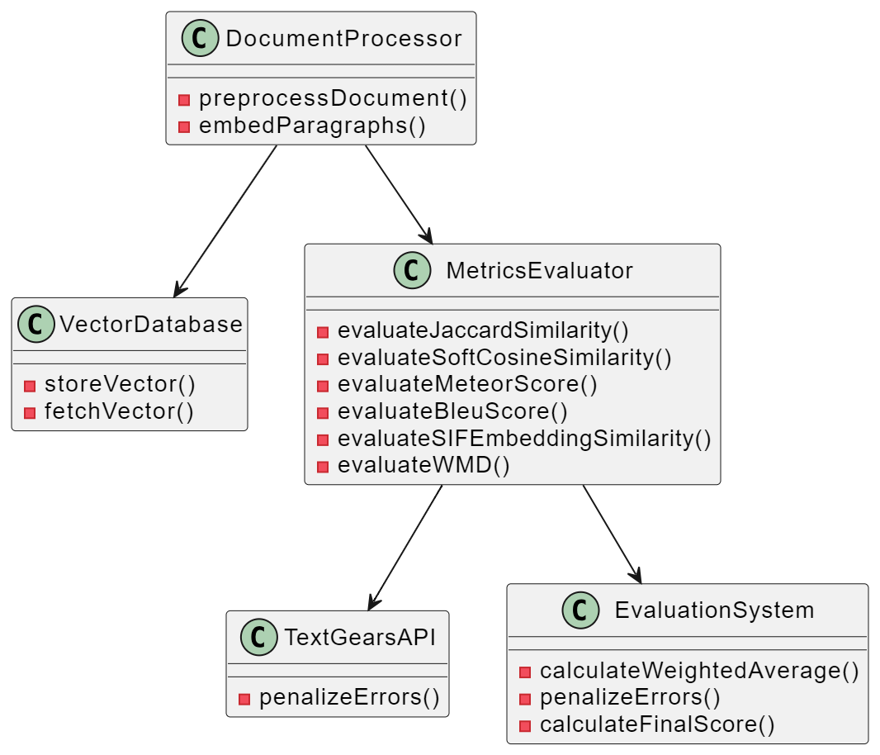
CLASS DIAGRAM:

Slide 21
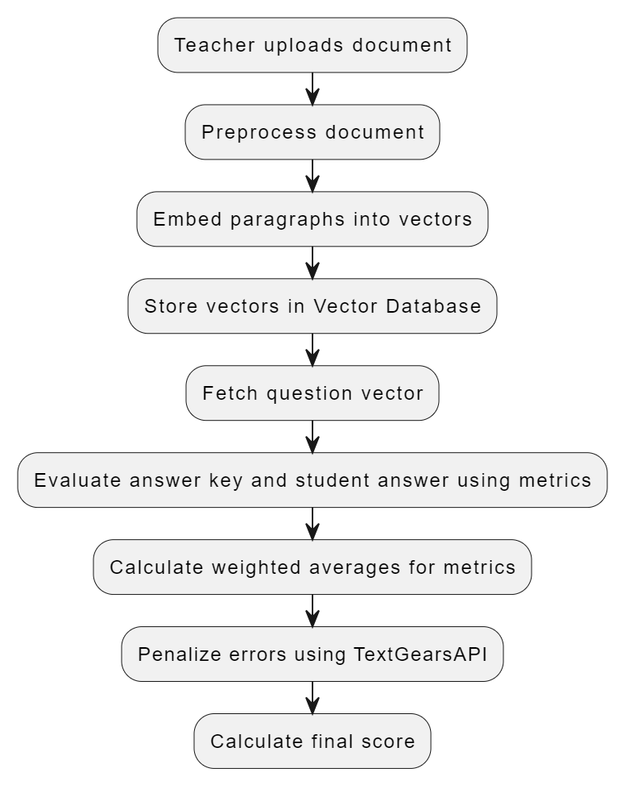
ACTIVITY DIAGRAM:

Slide 22
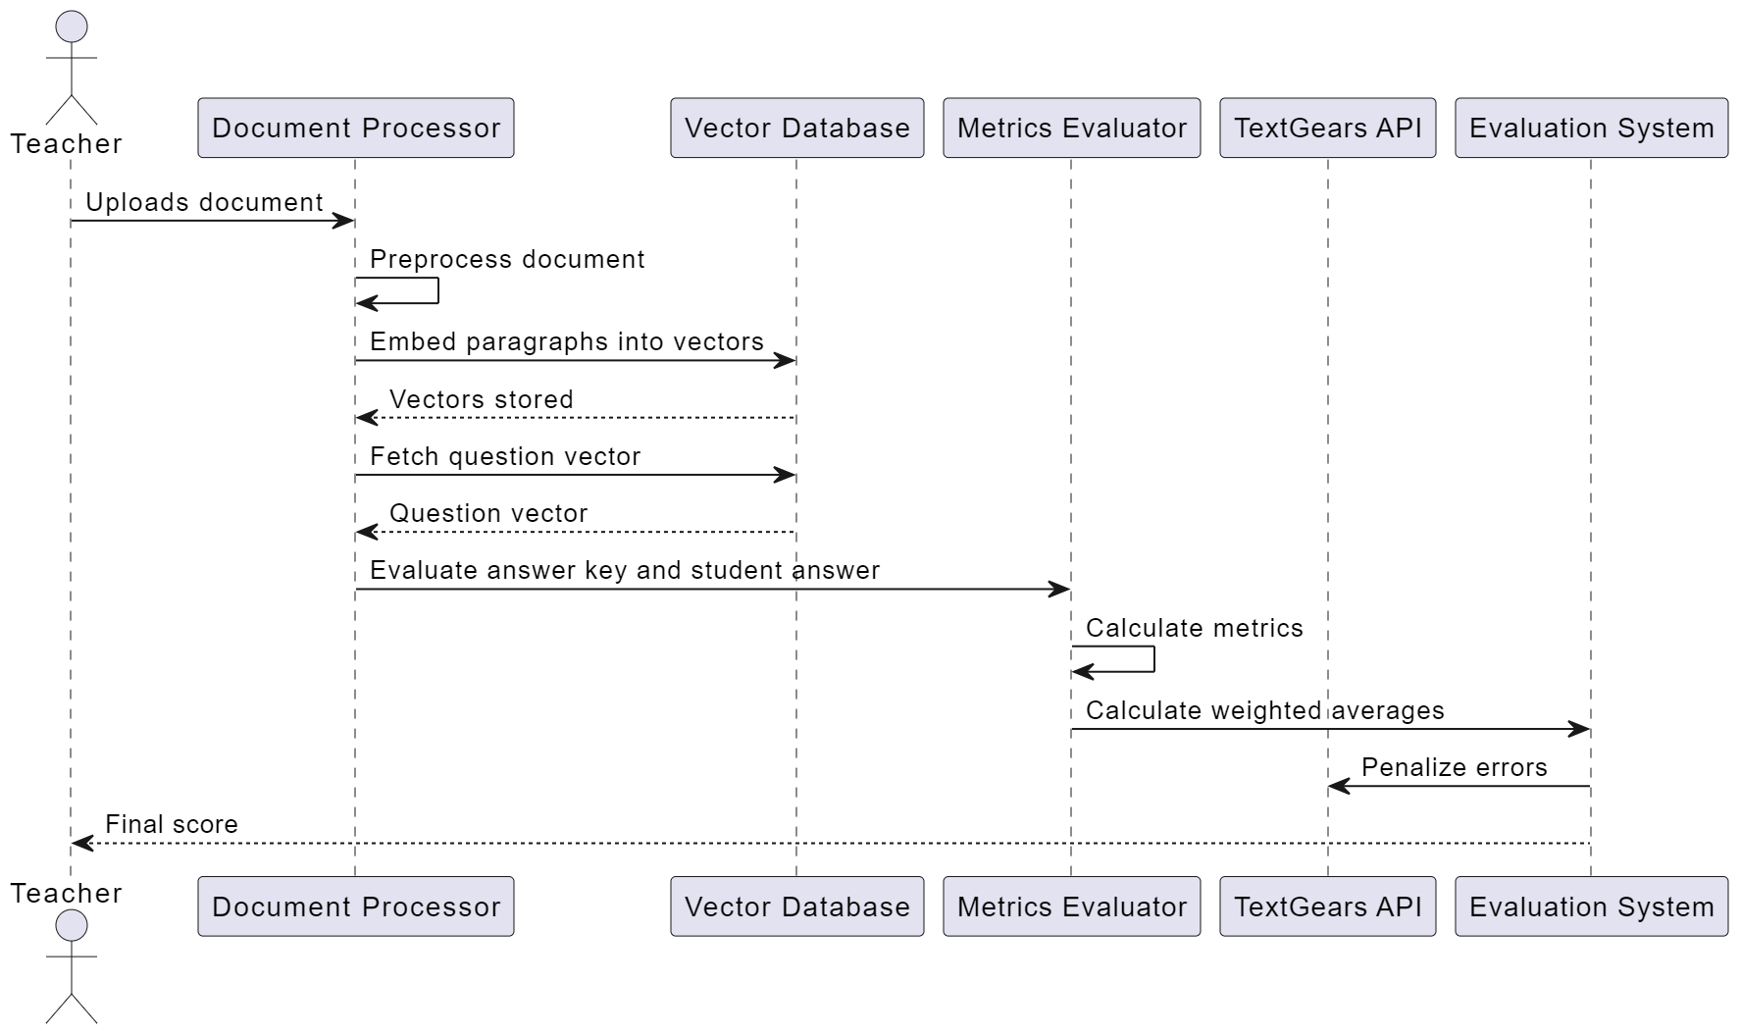
SEQUENCE DIAGRAM:

Slide 23
DEVELOPMENT:
In developing a system for evaluating subjective answers, several crucial steps must be meticulously followed. Initially, a diverse and representative dataset of subjective responses spanning various topics and levels of complexity needs to be assembled. Subsequently, the collected data undergoes preprocessing to clean and normalize the text, including tasks like tokenization and stemming. Feature engineering is then employed to extract pertinent features from the text, such as word frequencies or semantic embeddings, to enrich the evaluation process. Choosing an appropriate model, whether machine learning algorithms like recurrent or convolutional neural networks, or advanced transformer-based architectures, is pivotal. Training and validation phases follow, during which the model is trained on labeled data and evaluated using metrics tailored to subjective assessment, ensuring robust performance. Interpretability of the model's decisions is also prioritized, allowing educators to understand how the model arrives at its evaluations. Continuous refinement through iterative improvement cycles, informed by evaluation feedback, is essential for enhancing the system's efficacy over time. Once developed, the model is deployed into production environments, integrated seamlessly with existing educational platforms, and equipped with user-friendly interfaces for educators. Monitoring and maintenance procedures ensure the model remains effective and adaptable to evolving assessment needs, guaranteeing its long-term utility in subjective answer evaluation.

Slide 24


Slide 25


Slide 26
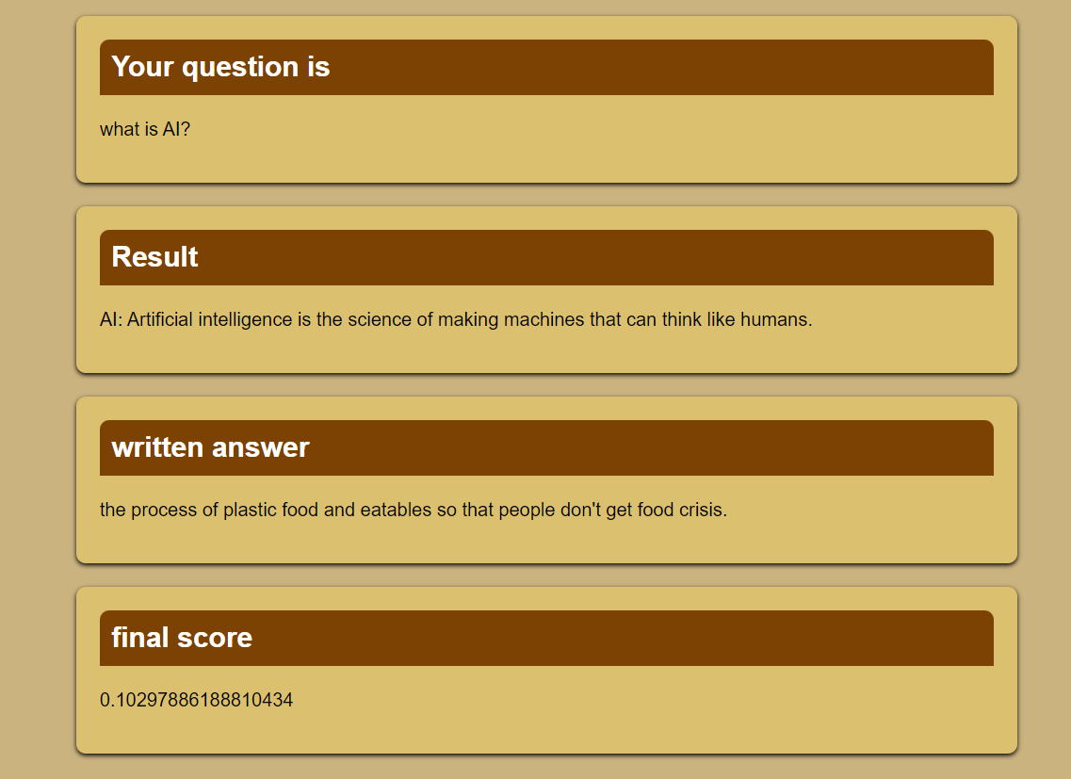

Slide 27
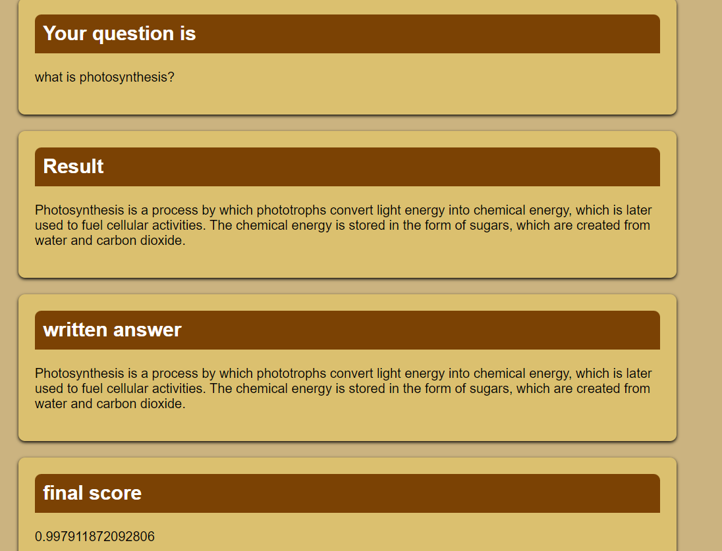

Slide 28
Future scope :
The project's future scope encompasses a range of possibilities that can further advance automated subjective paper evaluation. One promising avenue is the continual refinement and optimization of machine learning models employed for predicting answer grades. Through ongoing experimentation with diverse algorithms and feature engineering techniques, the system's accuracy and reliability can be significantly enhanced. Integration of deep learning methodologies, such as recurrent neural networks (RNNs) or transformer models, holds promise for improving the system's comprehension of complex textual responses.Moreover, the development of adaptive learning systems presents an opportunity to personalize the educational experience based on individual student performance insights. By analyzing students' responses and learning patterns, the system can provide tailored feedback and learning materials to address specific strengths and weaknesses, fostering a more effective learning environment.In addition, the implementation of real-time feedback and analytics features for both students and educators can further enrich the learning experience. Insights into students' progress and areas for improvement can empower educators to adjust their teaching strategies accordingly, while students can receive immediate feedback to guide their learning efforts.Ensuring scalability and seamless integration into existing educational platforms is crucial for the widespread adoption of automated evaluation systems. Compatibility with diverse infrastructures and the ability to handle large volumes of data will be essential considerations in the system's development.Furthermore, addressing ethical considerations, such as fairness, transparency, and bias, is paramount. Continuous monitoring and mitigation of potential biases in the system's predictions, as well as ensuring fairness in grading outcomes, are essential for maintaining trust and integrity in educational assessment.By pursuing these avenues for future development, the project has the potential to evolve into a comprehensive and robust solution that enhances educational assessment methodologies and improves learning outcomes for students. Continued research and innovation in this area will play a vital role in shaping the future of automated subjective paper evaluation and education as a whole.

Slide 29
CONCLUSION:
The project represents a significant step forward in the automation of subjective paper evaluation through the integration of advanced techniques from machine learning and natural language processing. By leveraging methodologies such as Word Mover's Distance (WMD) and Term Frequency-Inverse Document Frequency (TF-IDF), the project has demonstrated the potential to autonomously assess descriptive answers with remarkable accuracy and efficiency. The incorporation of additional similarity metrics further enriches the evaluation process, providing a more comprehensive understanding of semantic relationships within textual responses. Moreover, the exploration of machine learning models for predicting answer grades marks a pivotal advancement in streamlining the assessment process. The integration of predictive models offers a glimpse into the future of educational evaluation, where subjective papers can be graded with unprecedented speed and consistency. This not only alleviates the burden on educators but also ensures a fair and standardized assessment for all students. Beyond its immediate implications for educational assessment, the project's findings hold broader significance for the field of natural language processing and machine learning. By showcasing the efficacy of advanced techniques in handling complex textual data, the project contributes to the advancement of these fields, paving the way for future innovations and applications. The successful implementation of Word Mover's Distance and TF-IDF demonstrates their versatility and effectiveness in real-world scenarios, highlighting their potential for various other NLP tasks. Furthermore, the project underscores the importance of embracing technological advancements to address longstanding challenges in education. As the demand for personalized and adaptive learning solutions grows, the integration of automated evaluation systems becomes increasingly imperative. The project sets a precedent for the adoption of such systems in educational institutions, fostering a more efficient and effective learning environment for students worldwide. In conclusion, the project's achievements represent a significant milestone in the automation of subjective paper evaluation, offering promising prospects for enhancing educational assessment methodologies and shaping the future of learning and evaluation.

Slide 30
THANKYOU

